Slide 1
Counting process

Slide 2
Contents of the Presentation
Session No. | Name of the Topic | Total no. of Slides
I
 | 1.1 Major legal provisions related to counting 1.2 Infrastructure and security arrangements at counting centre 1.3. Appointment of counting staffs and counting agents
II | Counting of votes received through postal ballot / ETPBS
III | Counting of votes recorded in EVM-VVPATs | 46
IV | 4.1 Declaration of results
 | 4.2 Sealing of EVM-VVPATs and other papers
 | 4.3 Miscellaneous issues

Slide 3
3. Counting of votes recorded in EVM-VVPAT

Slide 4
Opening of Strong Room
The RO should commence the counting at the hour fixed for the purpose.
The strong room should be opened, in the presence of RO/ARO(s), candidates/ election agents and ECI observers.
After making necessary entries in the log book maintained for the purpose, the seal of the lock should be checked and then broken.
Videography.

Slide 5
COUNTING PROCESS
EVM counting starts ,after commencement of postal ballot counting,
Only CUs and sealed envelopes containing Form 17 C shall be brought to the table as per EVM Movement Sheet,
One senior officer to monitor the movement of CUs from strong Room to Counting Hall, one round after another,
Then to sealing place,
Only after completion of one round in all respect, CUs of next round will be moved to counting hall.
An account on such distribution of CUs shall be kept and brought to the notice of RO time to time.

Slide 6
COUNTING PROCESS
Every round of counting includes:
Placing of CUs & sealed Form 17 C in counting table as per EVM Movement Sheet,
Ascertaining of result from CUs & filling up of Form 17 C part II,
Preparation of Table wise proceeding with signatures of counting agents,
Supply of photocopies of Form 17 C part II to counting agents,
Parallel counting of two randomly selected EVMs,
Round wise tabulation with signature of RO & Observer,
Announcement & display of round wise result by RO,
Shifting of CUs for sealing.

Slide 7
STAGES OF TABLE COUNTING
Remove the seals from carrying case and take out CU.
Allow the counting agents to verify unique numbers of Pink Paper Seal, Outer Paper Seal, Special Tag and Green Paper Seal.
Open the outer cover of the ‘Result’ section.
Check Special Tag and Green Paper Seal.
Switch ‘on’ the control unit.

Slide 8
STAGES OF TABLE COUNTING
Poll date and poll start time and poll end time displayed on the CU should be verified from the record and shown to the polling agents.
Pierce the paper seal over the Result button.
Press the ‘Result’ button.
Show the display panel to the candidates If required, Result button can be pressed again to enable the candidates/ Counting Agents to note down the result.
Then close the cover of Result section .
Switch ‘off’ the control unit.
Proceeding to be prepared with signatures of counting agents.

Slide 9
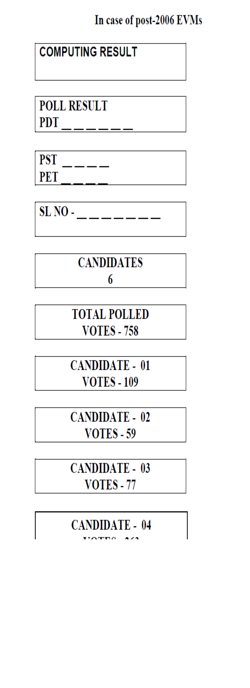
Display in Control Unit

Slide 10
evm counting
Switch “ON” Control Unit
Pierce Paper Seal over Result & Press Result
Note down in “Part II-Result of Counting” of 17C-Duplicate using Carbon Paper
Switch “OFF” the Control Unit
Other 17C Part II Photocopy - to all agents
17C Part II (First Copy) to RO/ARO for compilation
Counting Supervisor will keep 2nd Copy of 17C Part II
Put it in envelope & Seal it

Slide 11
PREPARATION OF FORM 17C PART II
Candidate wise and for NOTA – Votes to be recorded.
To be prepared in duplicate.
First copy to be given to RO/ ARO for computing round-wise result.
Second Copy- To be used for photocopy.
Photocopy – round-wise and table-wise to be given to candidates.
Original second copies to be returned back to counting supervisors.
Table-wise copies of Form 17C to be kept in an envelope superscribed “Duplicate copy of result of counting in Form 17C Part II”.
This envelope is to be handed over to the RO.

Slide 12
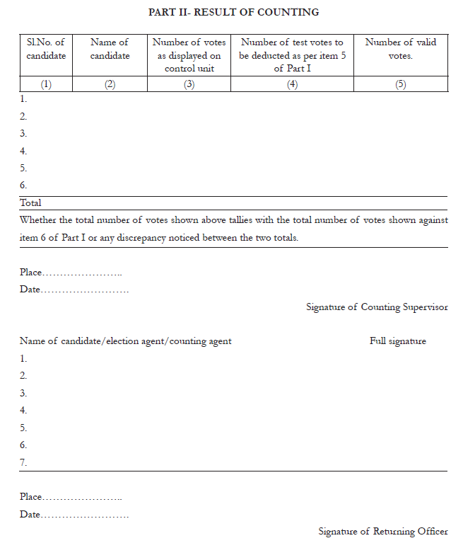

Slide 13
Cross checking by observer
Observer randomly select 2 EVMs of each round.
Additional counting staff to assist the observer.
If any discrepancy is found –
Result of the round of each table shall be re-verified from the EVM.
Staff will be removed – severe disciplinary action.
Result of such staff in previous rounds would be checked.

Slide 14
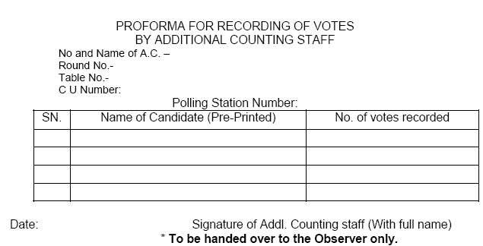
Counting of votes recorded in EVMs
Proforma for recording of Votes by Additional Counting Staff

Slide 15
Trend Result
Polling Station-wise round-wise Statement.
Both Computer/Manual entry – cross checking.
Both RO and Observer to get satisfied and sign
Thereafter RO should announce the result of the round/display on Blackboard/ Whiteboard.
Copy of Trend Result of each round to – a) All Candidate/Election agents, b)Media Room, c) Communication Room for uploading on GENESYS d) To the CEO

Slide 16
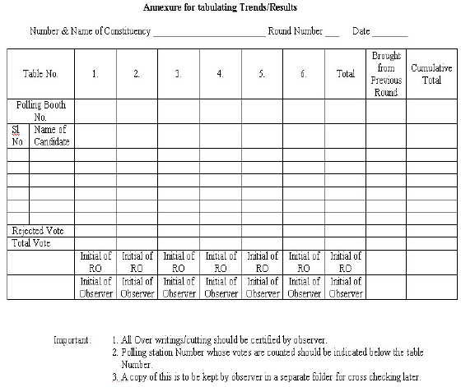
Counting of votes recorded in EVMs
Round wise statement proforma

Slide 17
Counting of votes recorded in EVMs
Officer compiling result in Result Sheet in Form 20 will do so strictly as per entries in Part II of Form 17 C.
He will note down no. of tendered votes polled, if any, in Form 20. Take note that these are not to be counted.
For AC, Final Result Sheet, You need to prepare only Part I of Form 20 where you mention no. of postal votes received by each candidate. In LS election Part II also to be filled up.
After all details have entered in Form 20, enter the grand total credited to each candidate, grand total of postal and votes polled at PS
Carefully check entire Form 20 if all entries have been made for every PS and it is not incomplete
Grand total should be entered accurately as discrepancy in the form will affect the result of election and declaration of result. This will invite severe disciplinary action

Slide 18
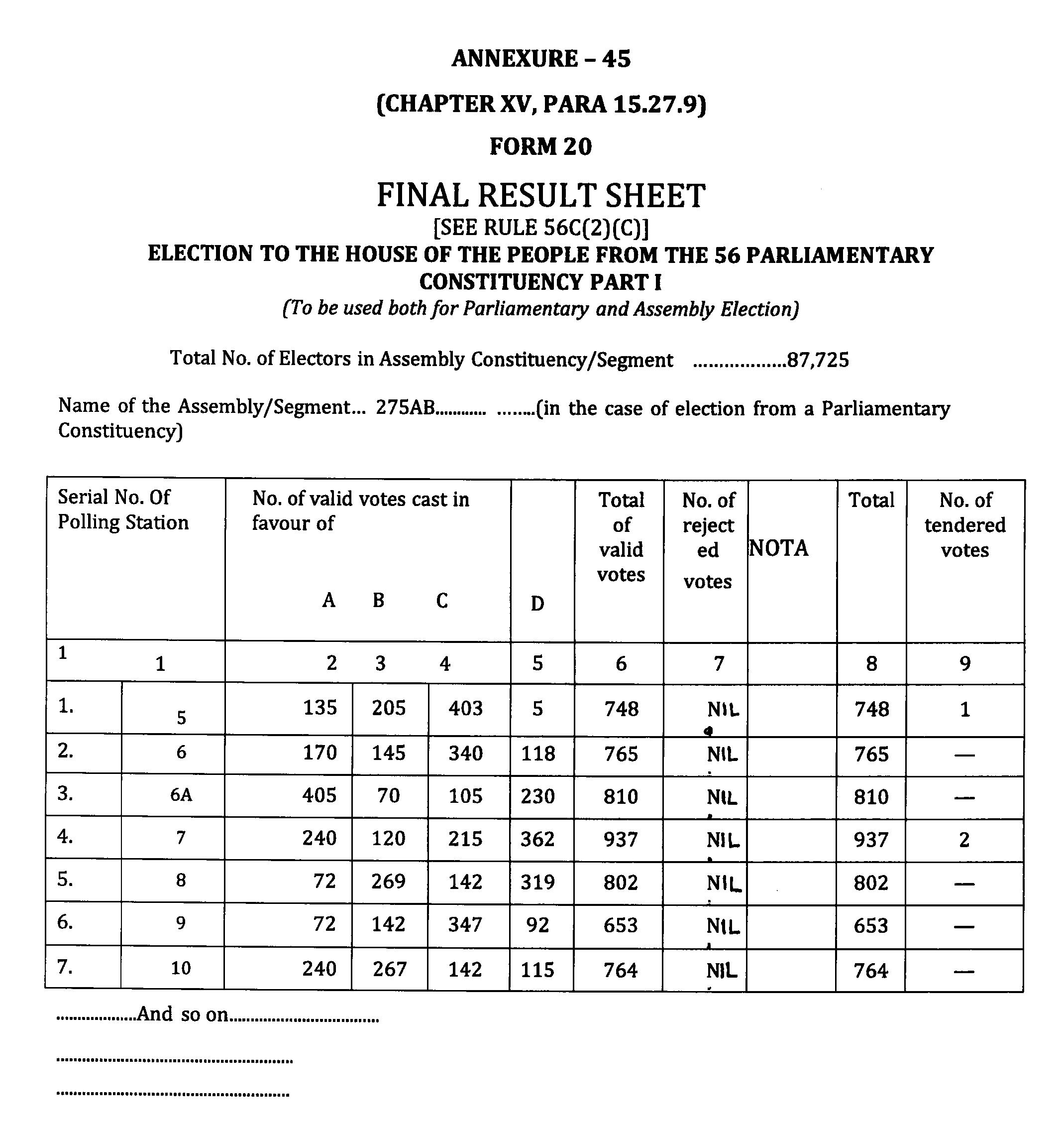
43

Slide 19
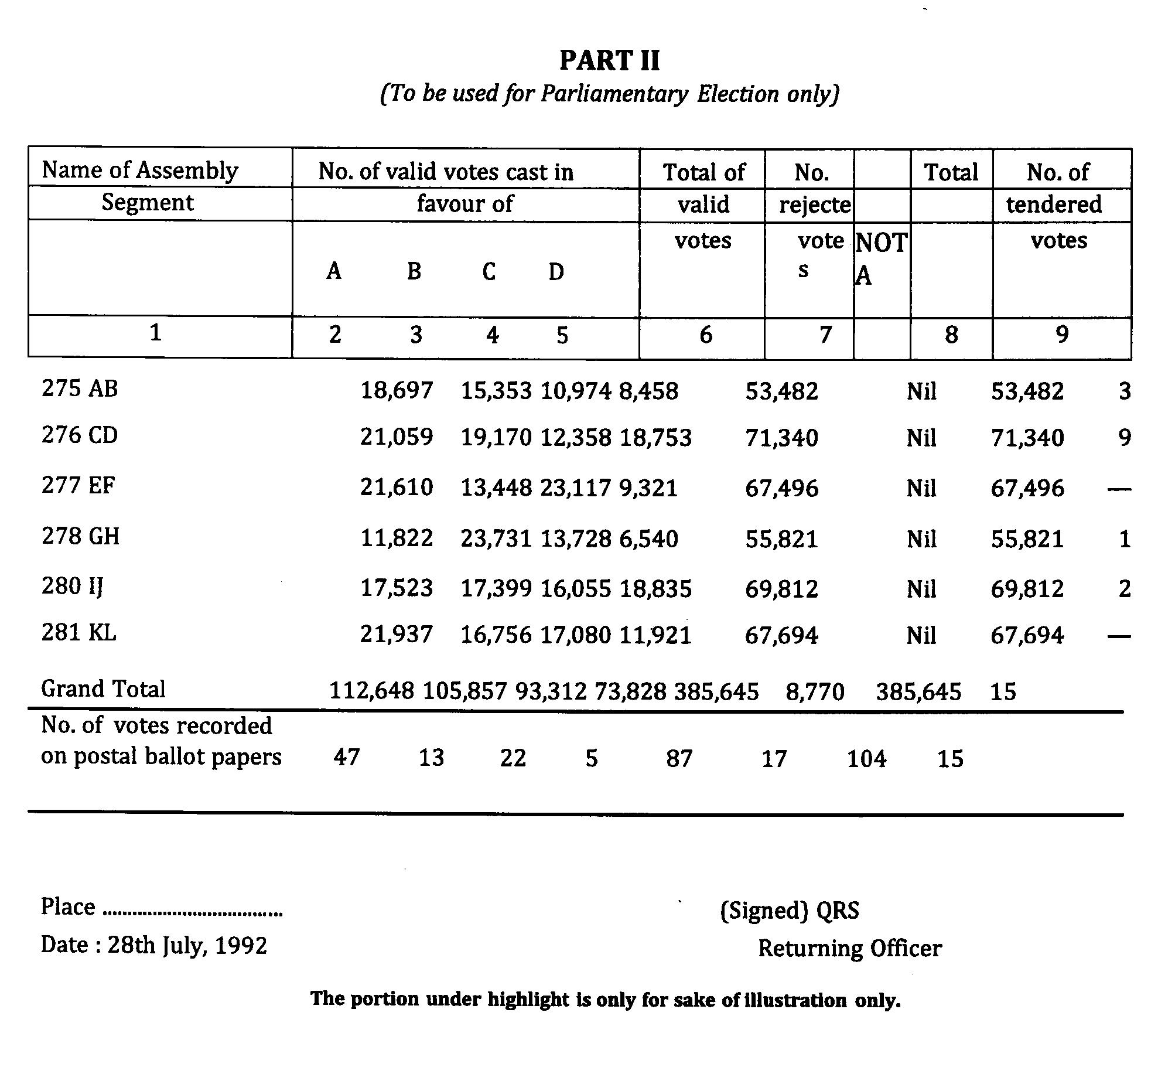
44

Slide 20
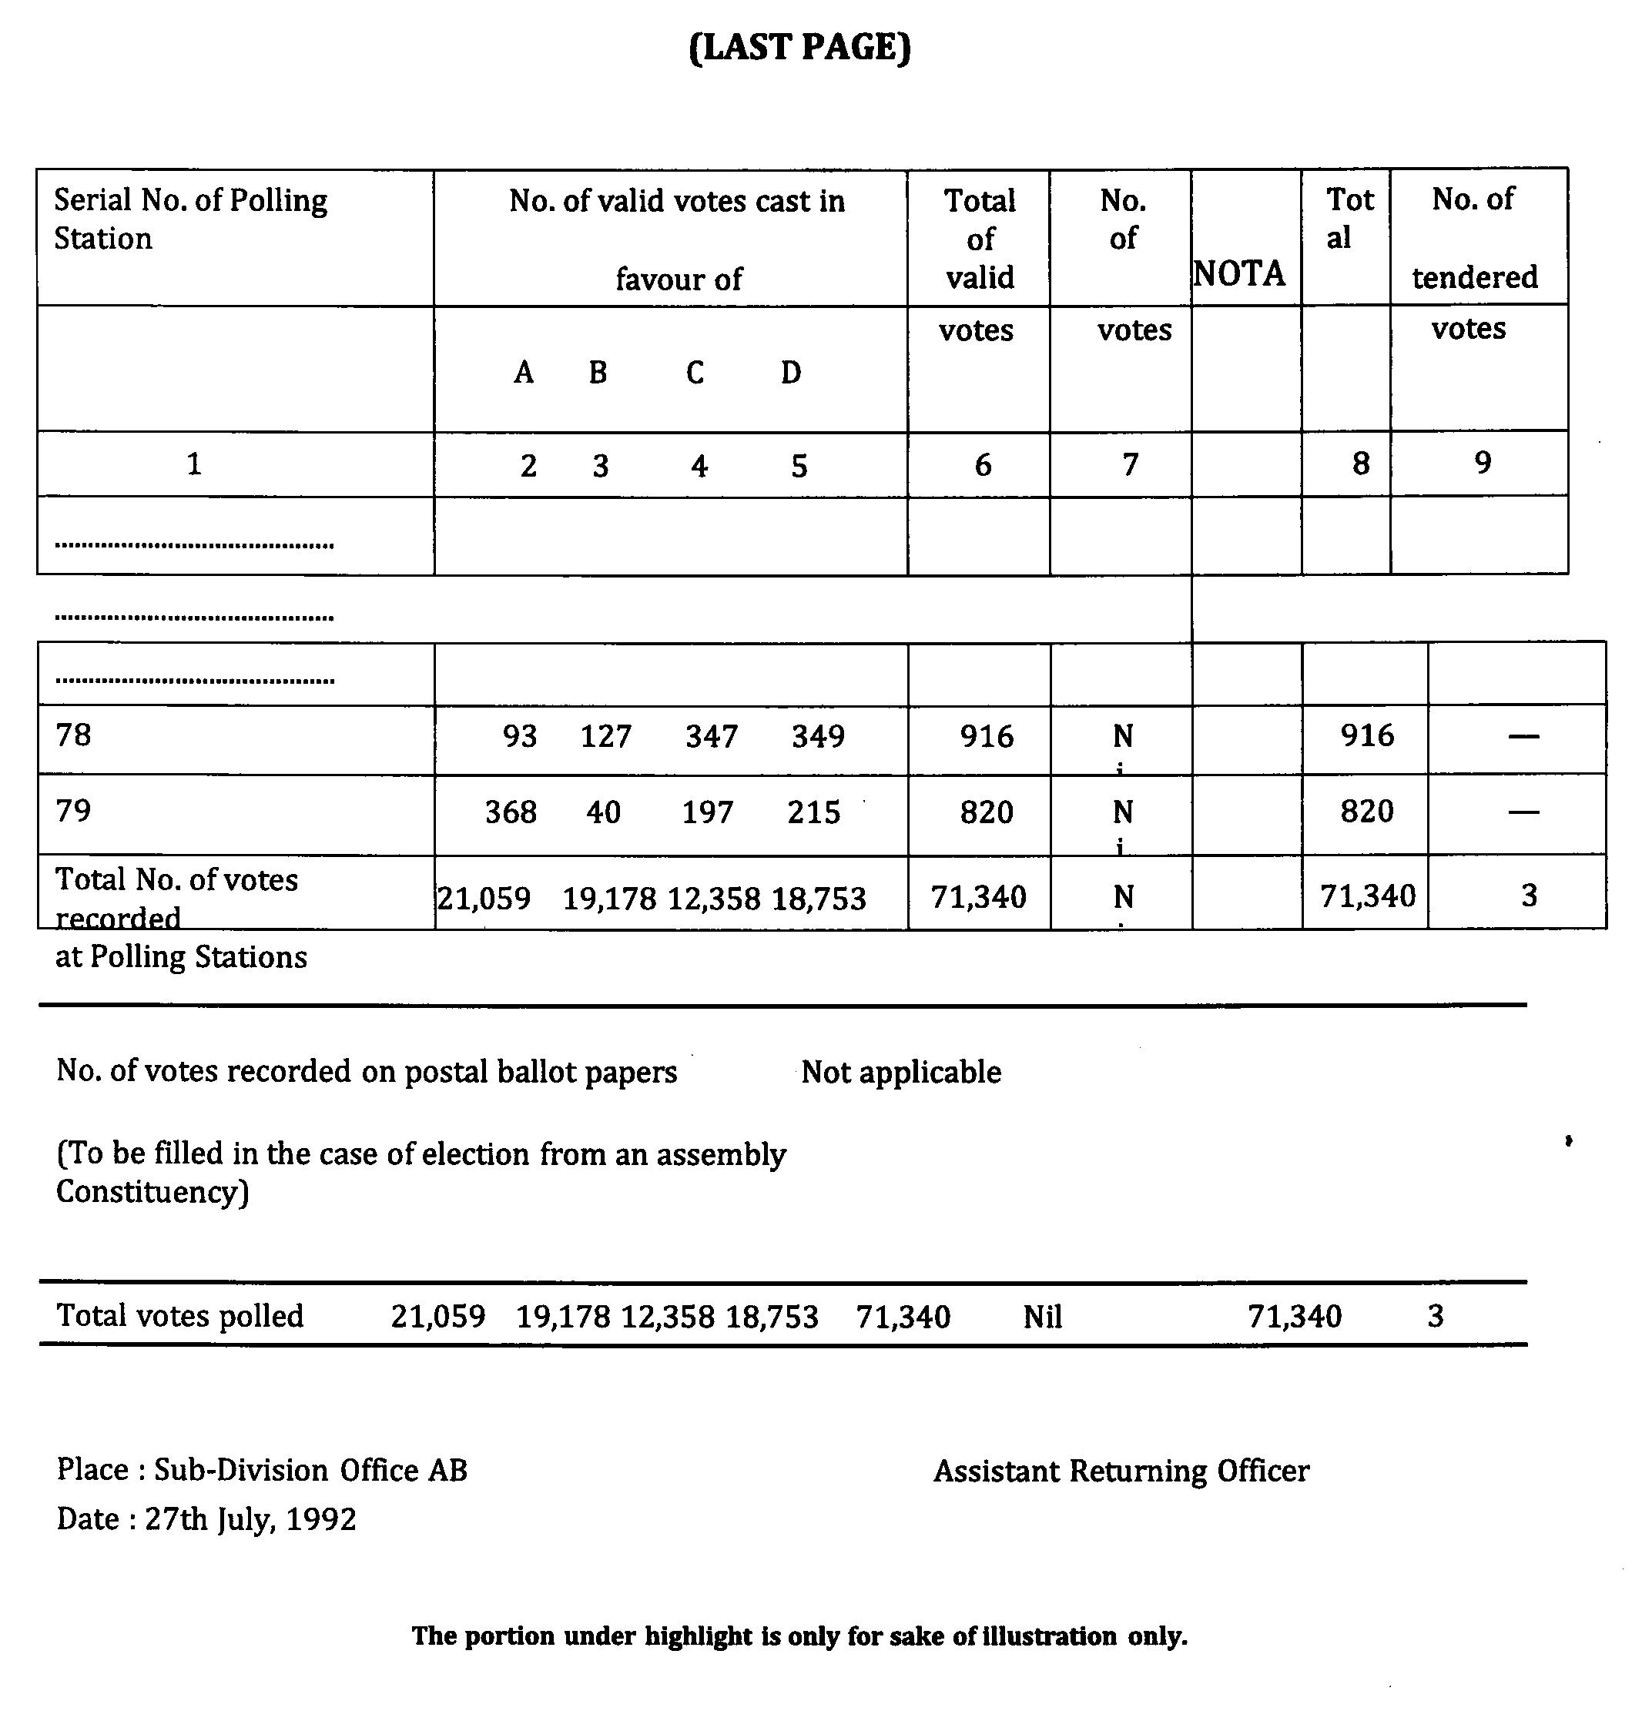
45

Slide 21
Counting of votes recorded in EVMs
After all rounds are completed and final result sheet in FORM-20 is ready, RO SHOULD NOT immediately sign it.
Before announcing , pause for 2 min during which candidate/agent can ask for recount for PB or for all rounds for some round/s.
Ascertain how long he will take to make an application for recount in writing
If time requested is reasonable, announce exact hour and minute till which you will be waiting

Slide 22
Counting of votes recorded in EVMs
If time requested is reasonable, announce exact hour and minute till which you will be waiting
Consider the grounds urged in application and decide if valid in whole or part. Reject entirely if found unreasonable/frivolous
Reason for accepting or rejecting the application should be recorded in detail
After careful recount, make changes if any in Form 20 and announce the same. Complete and sign Form 20
After observer’s clearance is obtained, announce the result

Slide 23
RECOUNT
Rule 63 of the Conduct of Election Rules, 1961
After completion of Counting and Final result sheet in Form 20 has been prepared:-
RO should announce total number of votes polled by each candidate in Form 20.
RO should pause for a minute or two.
Candidate/ Election Agent or Counting Agents, asks for a recount.
RO to ascertain, how much time he would require for making written application.

Slide 24
RECOUNT
Candidate can request recount of postal ballot and/ or polled EVM of all or some polling stations.
RO not to sign Final Result Sheet in Form 20 until after the expiry of the time.
RO to consider grounds urged and decide the matter judiciously – may allow whole/ in part.
RO to record reason for decision.
RO’s decision is final.
Videography.
Candidate has right to file request for 2nd recount.

Slide 25
COUNTING OF VOTES in VVPATs
IMPORTANT INSTRUCTIONS OF THE COMMISSION
51/8/VVPAT/2017-EMS, dated 05.12.2017
51/8/VVPAT/2017-EMS, dated 20.12.2017
52/LET/ECI/FUNC/JUD/SDR/2018-Vol.I, dated 09.02.2018
51/8/VVPAT-INST/2018-EMS, dated 13.02.2018
51/8/VVPAT/2018/EMS, dated 01.03.2018

Slide 26
COUNTING OF VOTES in VVPATs
Ballot Slips of VVPAT counting is/may be due to:
Mandatory counting of ballot slips of VVPATs of one polling station for each Assembly Constituency/Segment;
If electronic result from the Control Unit of EVM of any polling station can not be retrieved ( No more use of ADU);
Recount of ballot slips of VVPATs of any/all polling station is requested by the candidate/election agent( in due manner) and allowed by the Returning Officer.

Slide 27
COUNTING OF VOTES in VVPATs
Counting of votes shall be done according to rule 56C of the Conduct of Elections Rules, 1961.
After announcement of result sheet entries , any candidate or his election/counting agent may apply in writing to the RO according to rule 56D of the Conduct of Elections Rules, 1961 to count the printed ballot slips of any or all polling stations .
RO shall pass a speaking order, whether the counting of printed paper slips shall be done or not.

Slide 28
While deciding RO will give due consideration to-
a) Whether the total number of votes polled in that polling station is more or less than the margin of votes between winning candidate and candidate making application ;
b) Whether EVM met with any defect and was replaced during poll;
c) Whether there was any complaint about VVPAT not printing the paper slips or complaint under rule 49MA by any voter in that polling station during poll.

Slide 29
Counting of Votes (Contd…)
If RO decides to allow counting of printed ballot slips following procedure shall be followed-
a) VVPAT unit(s) of the respective polling station(s) shall be brought to the VVPAT Counting Booth (VCB) [one table to be earmarked as VCB].
b) VCB shall be enclosed in a wire-mesh just like a Bank Cashier
Cabin, so that no VVPAT paper slip can be accessed by any
unauthorised person.
b) Address tag(s) of the drop box of the VVPAT unit(s) shall be cross checked to ascertain that it actually pertains to the same polling station.
c) Address tag(s) of the drop box should be removed and printed paper slips shall be taken out and empty drop box should be shown to all counting agents.

Slide 30
PROCEDURE TO COUNT PAPER BALLOT SLIPS
For keeping VVPAT Paper Slips taken out from the Drop Box of the VVPAT, a sufficiently sized sturdy transparent plastic container with lid, of dimensions 14 inch X 10 inch X 5 inch (length x breadth x height), to easily accommodate around 1400 Printed Paper Slips, shall be kept on the table of VCB.
For keeping VVPAT paper slips of the respective candidates, a Pigeonhole Framework shall be prepared in advance according to the number of candidates including NOTA, with one additional pigeonhole for keeping self-test slips of the VVPAT, and shall be kept on the table of VCB.
The symbol of each contesting candidate as per the Ballot Paper should be affixed on the wall of the pigeonhole allotted to the particular candidates. The symbol should be printed in black and white on a plain paper of minimum size 4inch X 3 inch.

Slide 31
PROCEDURE TO COUNT PAPER BALLOT SLIPS
Uncut , partially printed ,self test reports shall be kept as part of record. Can be easily identified as it does not contain sl. no , name, symbol of candidate and larger in length.
Ballot slips shall be put in pigeon holes and prepared for counting in bundles of 25.
Result of the VVPAT paper slips count shall be prepared in the format as per Annexure-VII (of the order of ECI dt. 05.12.2017) and attached to Part-II of Form 17-C.
The result of the count of VVPAT paper slips shall be announced loudly in the counting hall and shown to the counting agents.
If there is any discrepancy between EVM count and paper slip count, the paper slip count shall prevail. Hence, if there is discrepancy between the count of votes displayed on the Control Unit and the count of printed paper slips in respect of that Polling Station, the result sheet will be amended as per the printed paper slips count.

Slide 32
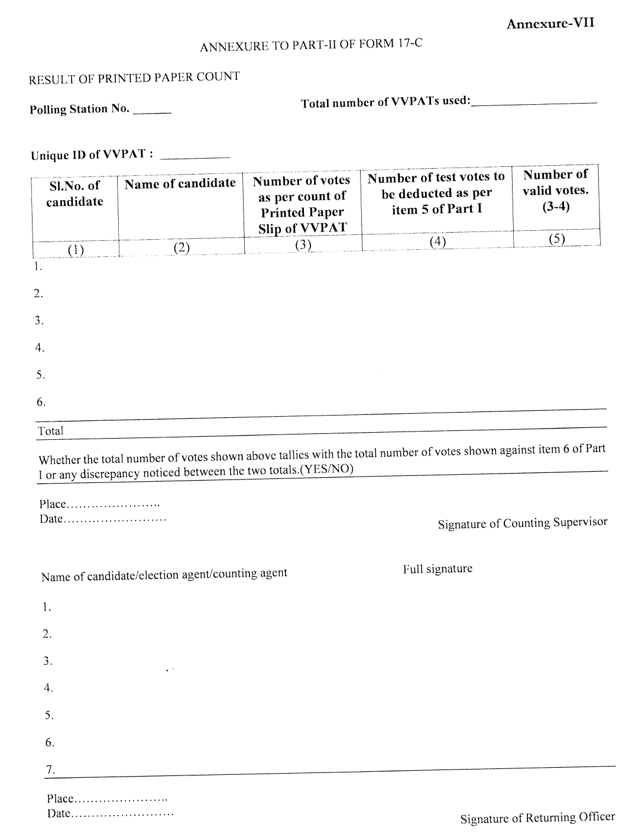

Slide 33
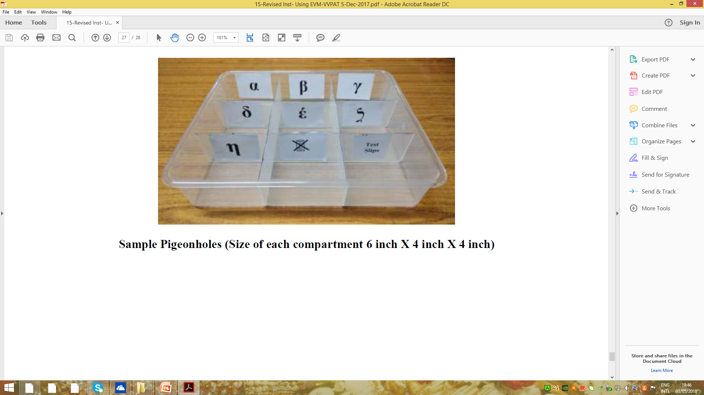

Slide 34
Procedure in case the close button not pressed at the end of the poll
In case any Control Unit does not display result due to not-pressing of “Close” button by the Presiding Officer in the polling station at the close of poll, it should be kept back inside its carrying case in the Returning Officer’s custody in the counting hall. Counting of votes in other machines should continue as usual.
When counting of votes in other machines is completed, the Returning Officer and Observer should see whether the margin of votes between the first candidate and the runner up is more or less than the votes polled in such machine(s).

Slide 35
Procedure in case the close button not pressed at the end of the poll
In both the cases where the margin of votes is more or less than the total votes polled in that machine(s), the Returning Officer/Counting Supervisor shall press the “Total” button of the Control Unit to see the total votes polled in that machine(s).
In case, total votes polled in the machine(s) tallies with the total votes polled mentioned in the Form-17 C, the Returning Officer/Counting Supervisor shall press the “Close” button of the Control Unit(s) so that “Result” button can be pressed for getting result data and the Returning Officer and Observer should send a detailed report to the Commission in the format mentioned at Annexure-25 of EVM-VVPAT Manual (July 2018).

Slide 38
Non retrieval of result from Control Unit - VVPAT used
If result is not displayed in a CU then it shall be kept back inside its carrying case and then be kept in the Returning Officer's custody in the counting hall. Counting of votes in other machines should continue as usual.
Result from such Control Unit will not be retrieved using Auxiliary Display Unit or Printer.
After completion of counting of votes from all the Control Units, the printed paper slips of the respective VVPAT shall be counted as per the counting procedure prescribed by the Commission

Slide 39
Non retrieval of result from Control Unit - VVPAT used
After counting of ballot slips candidate wise, total votes shall be
tallied with item 6 of part I of Form 17C of that polling station.
Result of the VVPAT paper slips count shall be prepared in the format as per Annexure-VII (of the order of ECI dt. 05.12.2017) and attached to Part-II of Form 17-C.
After completion of counting of VVPAT paper slips, the bundles of all
the VVPAT Paper Slips shall be kept back in the Drop Box of the
respective VVPAT and door of the Drop Box shall be sealed using
address tags.
The candidate(s)/their agents may also be allowed to affix their
signature with party abbreviation on the Address Tags.

Slide 40
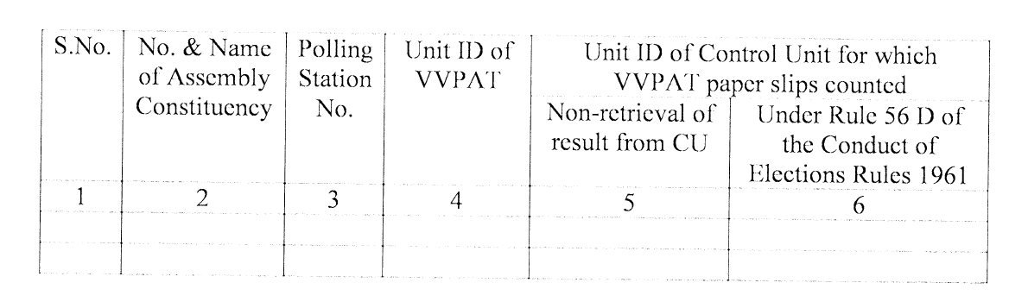

Slide 41
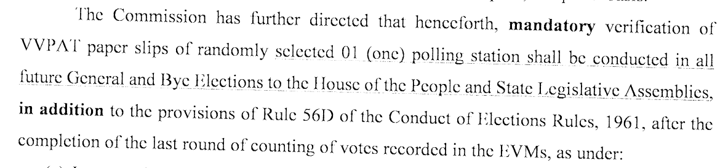
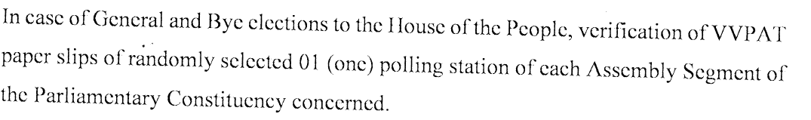
Mandatory verification of VVPAT Paper Slips of 01 randomly selected Polling Station

Slide 42
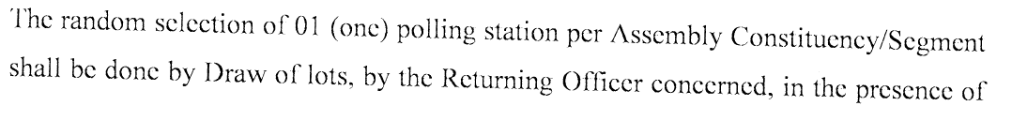
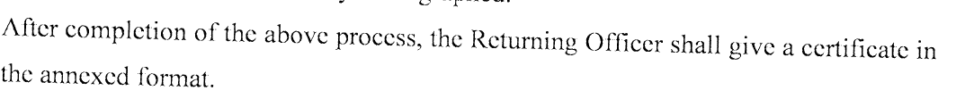

Slide 43
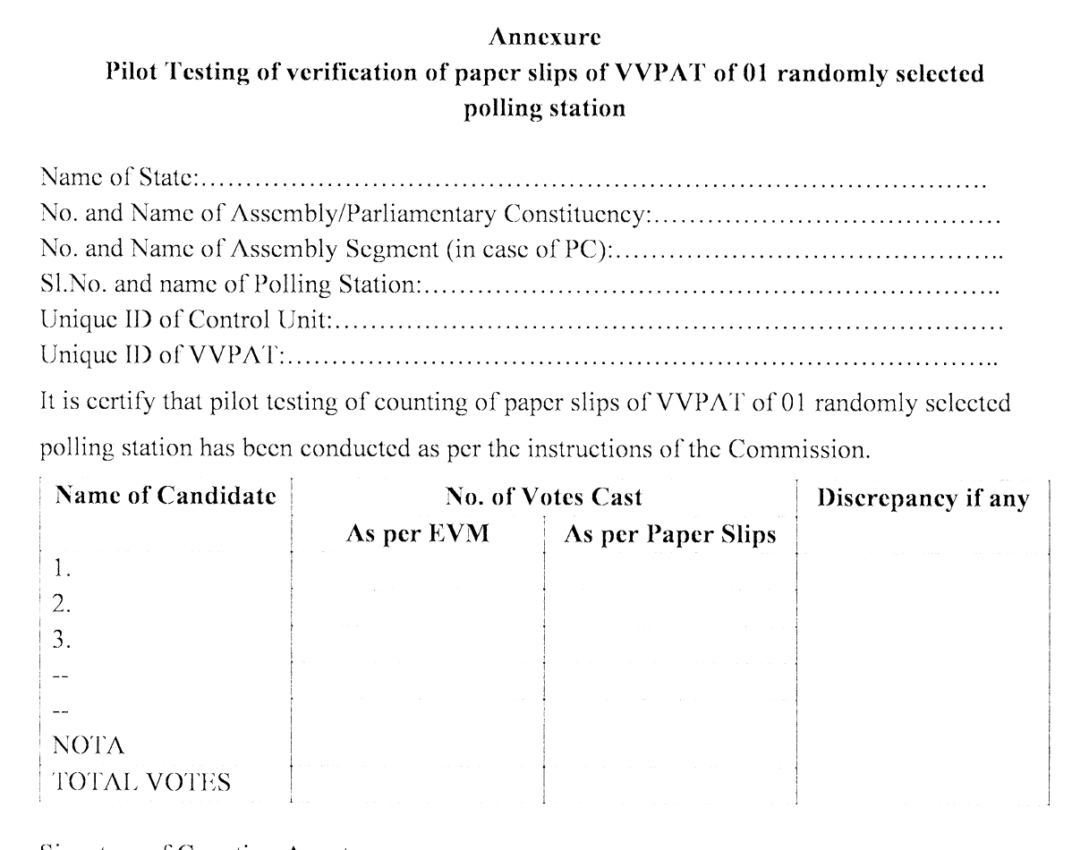

Slide 44
Counting of votes recorded in EVMs
PLEASE NOTE
Penultimate round of EVM counting shall not commence unless, POSTAL BALLOT counting is over.
RO’s duty is to accurately count the recorded votes. Hence RO can at any time order the staff to recount the votes.
In case the victory margin is less than total number of Postal Ballot received then re-verification of all postal ballot should be done, even if no candidate/agent has asked for it.
All the postal ballots rejected as invalid as well as counted in favour of each candidate shall once again be verified and tallied in the presence of RO and OBSERVER who shall record the findings of re-verification and satisfy themselves before finalizing the result.

Slide 45
Counting of votes recorded in EVMs
PLEASE NOTE (contd…)
Entire proceeding to be VIDEOGRAPHED and CD of such videography to be kept in a sealed cover for future reference.
Under no circumstance actual votes recorded on an EVM or ballot paper is to be photographed or covered by any audio visual coverage
Take care while doing videography, the focus is on activity and not on the actors
Media persons are to be taken inside counting hall in batches duly escorted by a senior officer

Slide 46
Thanks

